Slide 1
Acoustics
What is sound and how does it affect acoustic detection?

Slide 2

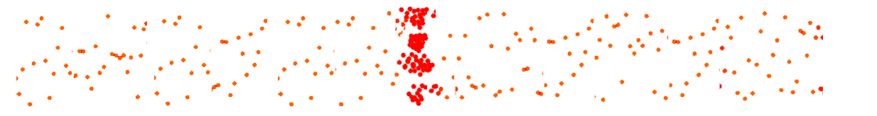

What is Sound?
Sound is vibrations in a medium
  Air
  Water
If the vibration is fast and hard enough, humans will experience it as a sound
  Frequency
  Pressure
Example: Gunshot
Compression of
Air Molecules
λ = v / f
Wavelength = velocity of sound
frequency

Slide 3
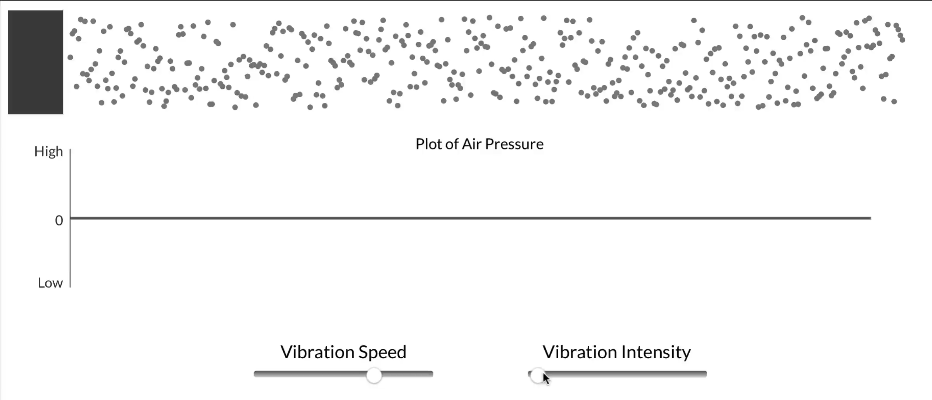
What is Sound?

Slide 4

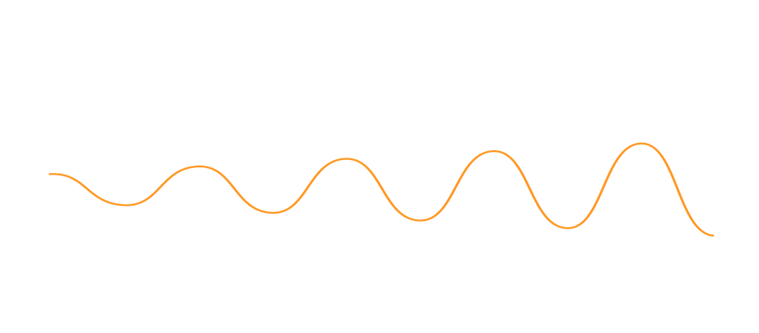
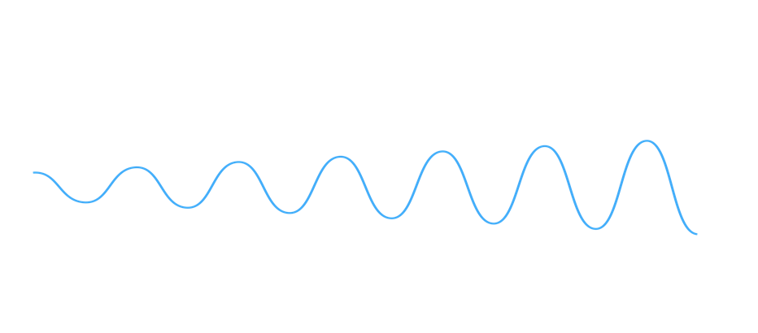
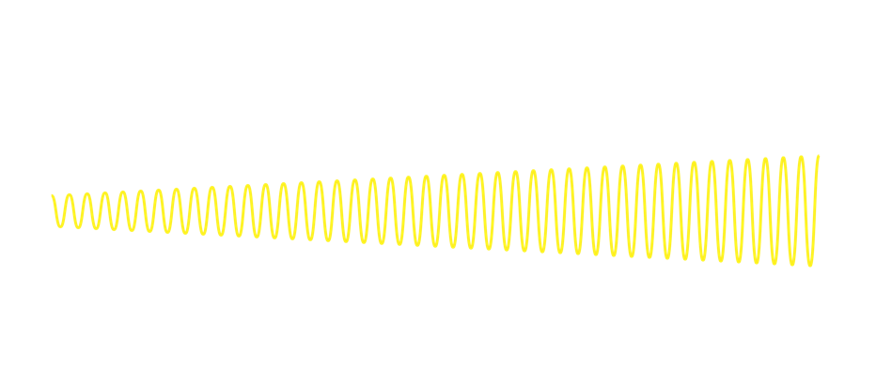

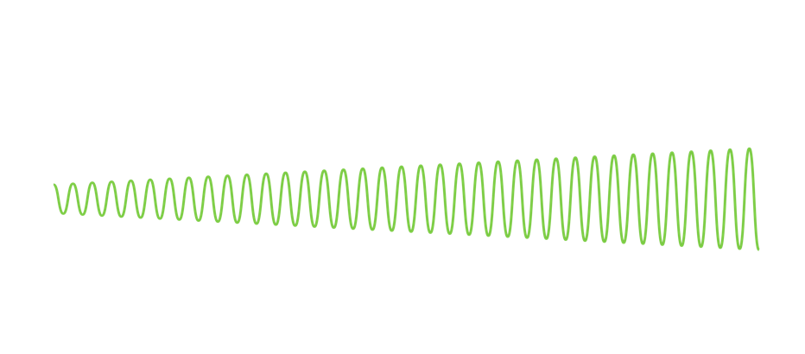

Frequency
300Hz = wavelength of 1m
1000Hz = wavelength of 35cm
Voice - mix of many frequencies
6000Hz = wavelength of 6cm
A sounds tone or pitch refers to it’s frequency
Low frequency:
  Helicopter
High frequency:
  Smaller high rpm racing drones, electric engines
Sounds are complex

Slide 5
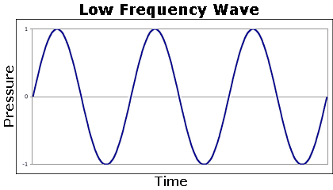
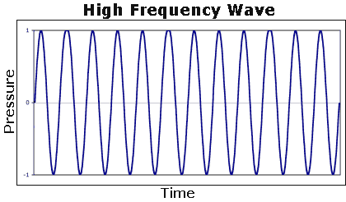

Frequency Range of Human Hearing
"Experiments have shown that a healthy young person hears all sound frequencies from approximately 20 to 20,000 hertz."

Slide 6
Sound pressure level
Sound pressure is measured in Pascal (uPa)
Usually expressed logarithmically as Decibel (dB)
  Referenced to 10 uPa, measured at 1 m

Slide 7
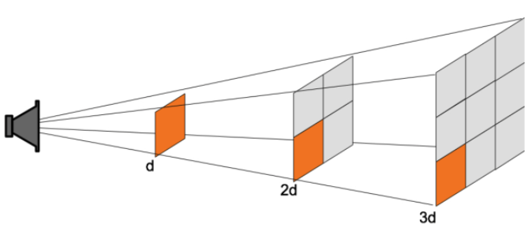
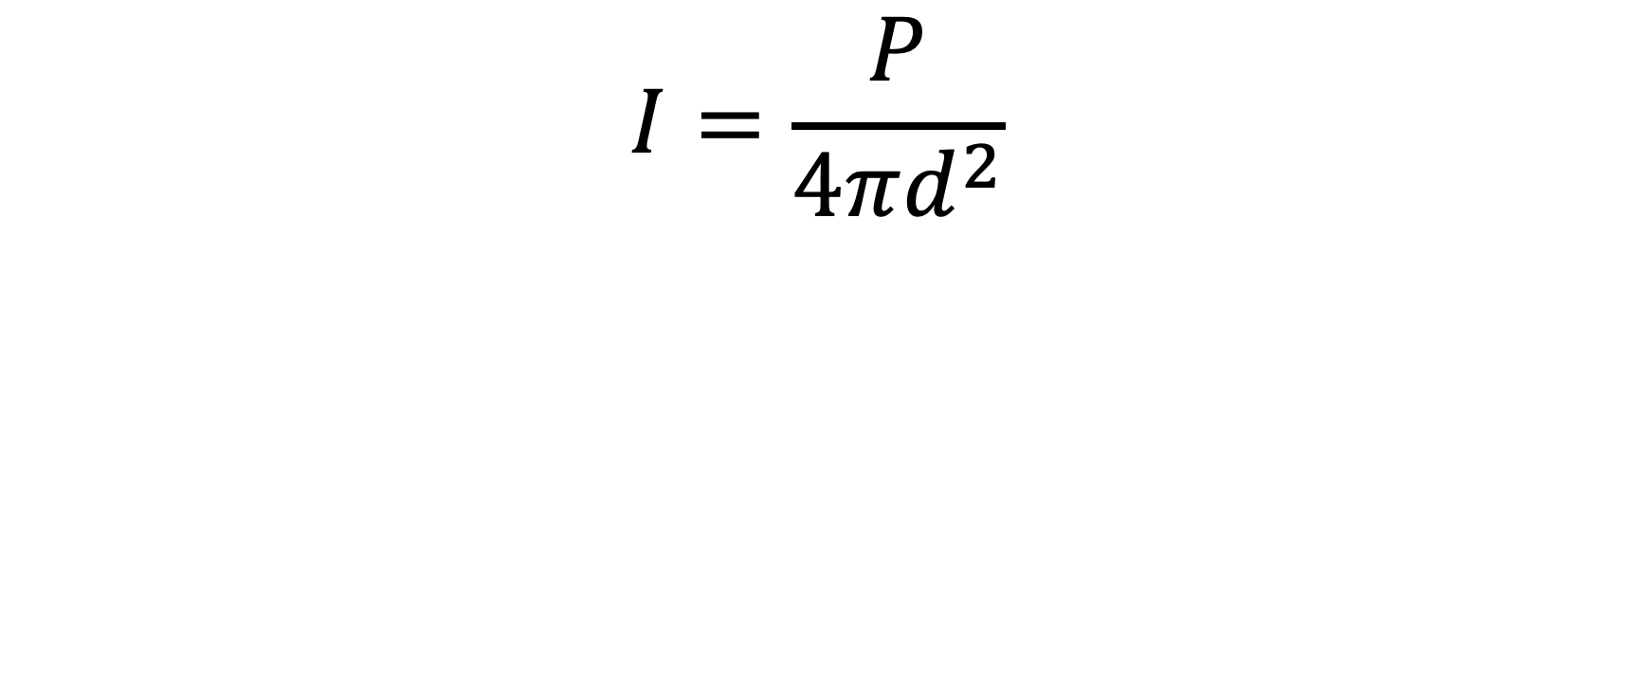
Inverse square law
$$I=\frac{P}{4πd^{2}}$$

Slide 8
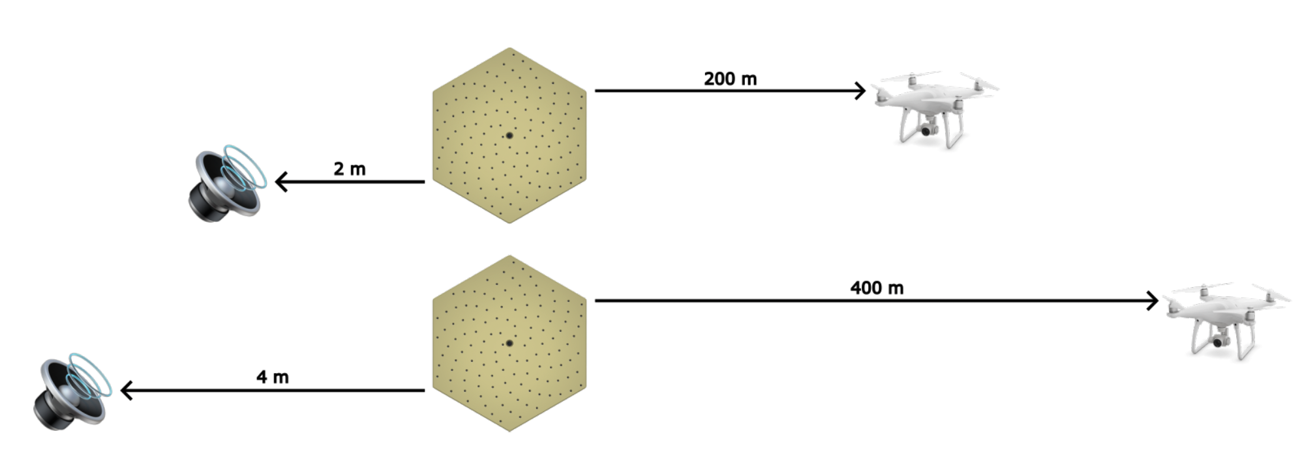
Inverse square law in theory

Slide 9


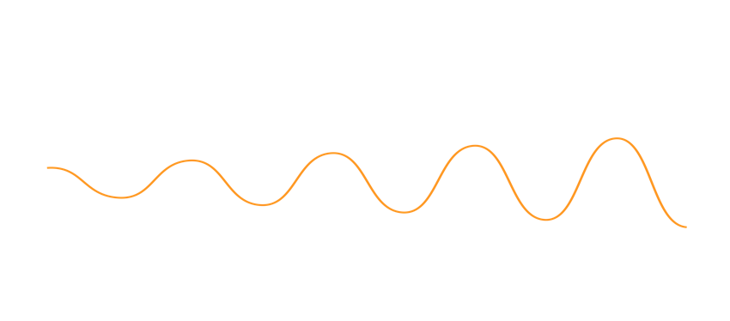
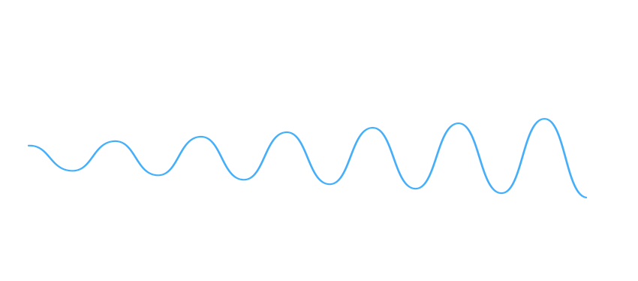


Absorption
Higher frequencies is absorbed easier than lower frequencies
Causes information loss in the sound
Examples
  Conversations in a neighboring room
  Concerts from a far
  Drones in the distance
Notes:
This is a limiting factor when it comes to recognising drones at long distances.
The low frequencies aren’t always enough to make it recognisable

Slide 10
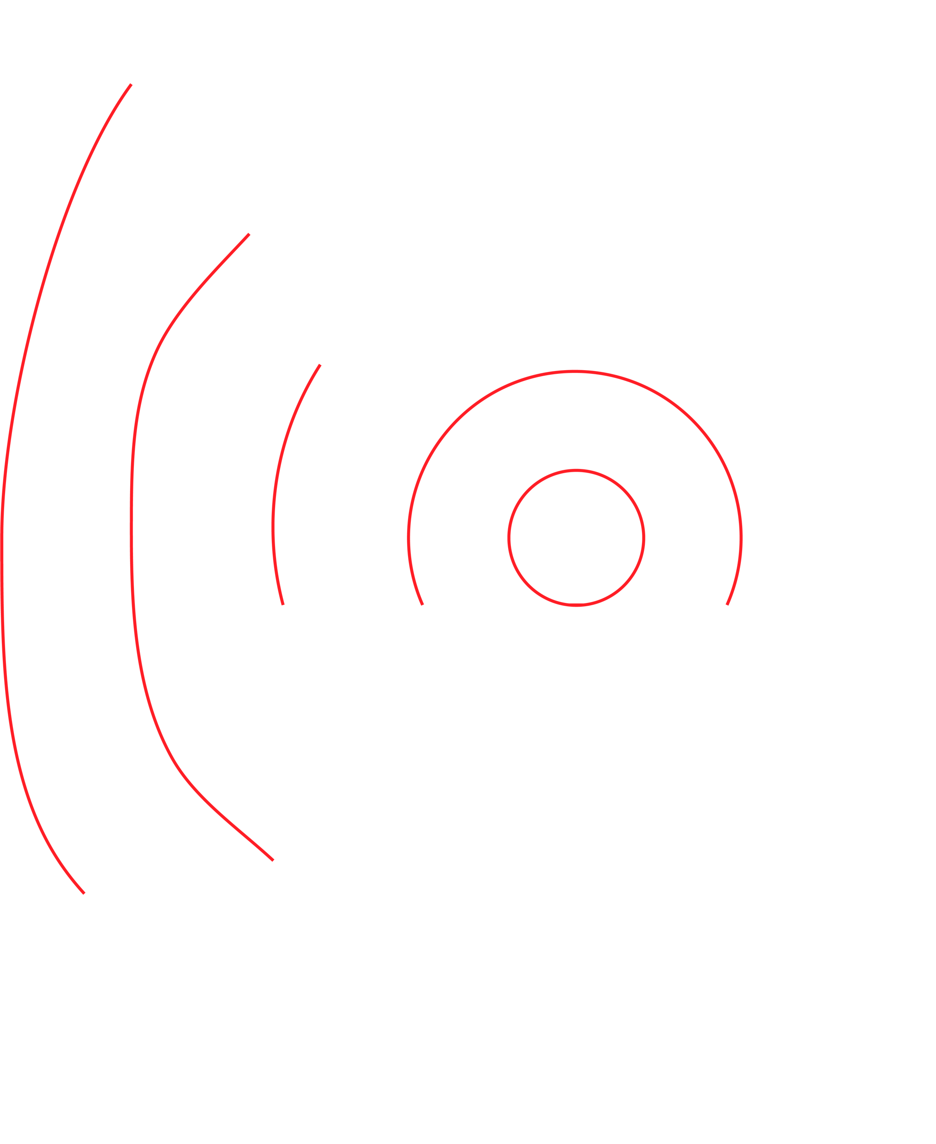

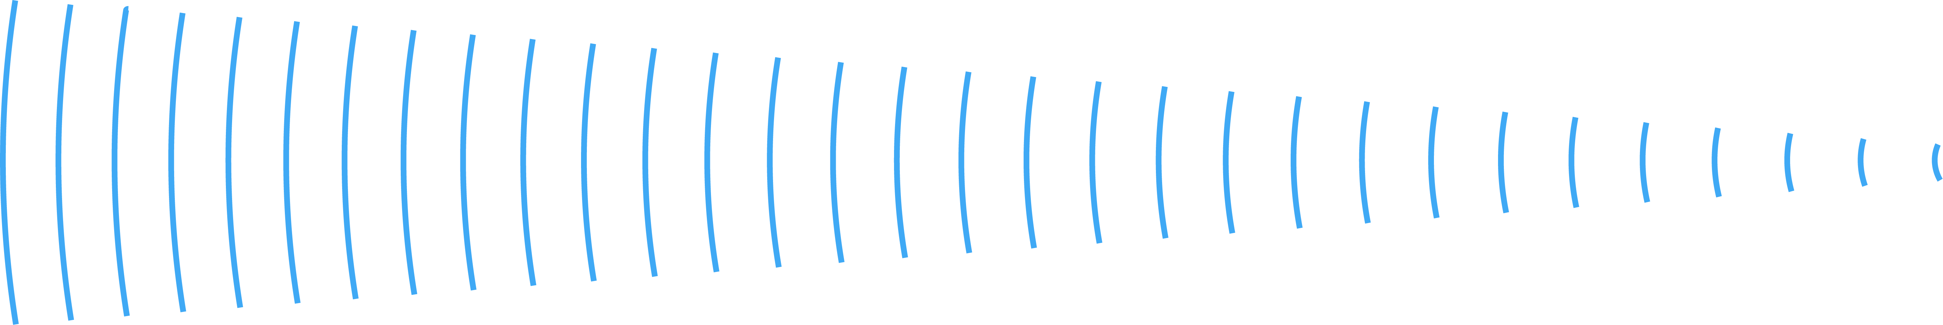



Behaviour of different frequencies
λ = Short wavelength
High frequency
High Freq
Directional – blocked by objects
λ = Long wavelength
Low frequency
Low Freq
Goes round objects

Slide 11
Temperature and acoustics
Higher temperatures, higher speed of sound
Sound tend to refract towards mediums with lower speeds
Negative influence:
  Warm ground, cold air higher up
  Sound will refract upwards
  Decreased signal strength at ground level
Positive influence:
  Cold air close to the ground, warmer higher up
  Sound will stay closer to ground
  Increased signal strength at ground level
Temperature | Speed of sound (m/s)
-40 | 306.2
0 | 331.4
5 | 334.4
10 | 337.4
15 | 340.4
20 | 343.3
25 | 346.3
30 | 349.1
40 | 354.7
50 | 360.3
60 | 365.7
70 | 371.2

Slide 12
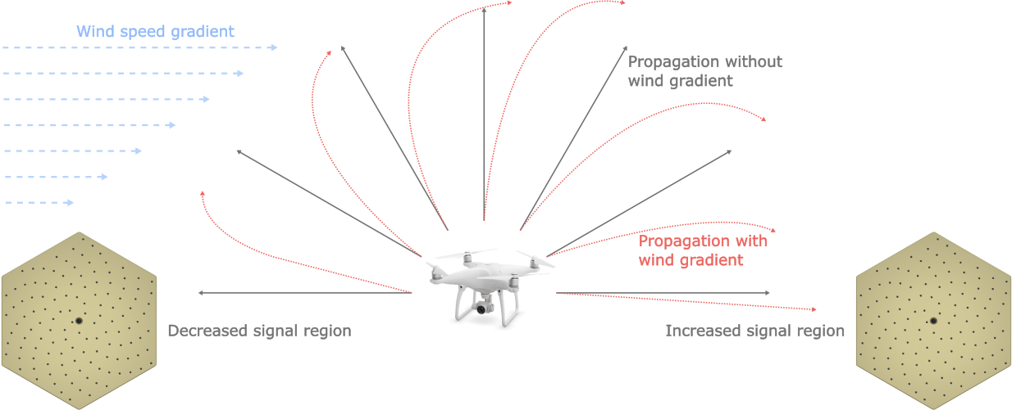
Wind and acoustics
Adds or subtracts to the sound speed
Headwind can amplify the signal
Tailwind can weaken the signal
In practice decreased detection range
  Due to increased ambient sound level

Slide 13

Sound or Noise?
Noise is unwanted sound
Noise from the same direction as what we want to focus on is problematic
  The frequencies generated by the noise source may mask the sound we want to hear
  Be aware of where to place the sensor in relation to what we want to focus on and possible noise sources.
Noise may be intermittent

Slide 14
Summary
Sound is a mixture of many frequencies.
For each doubling of distance from a sound source, the sound pressure level is decreased by a factor of 2.
  Doubling the distance to the noise source, can in theory doble your detection range.
High frequencies are stopped more easily than low frequencies.
Sound refracts towards mediums with a lower speed of sound.
  Sound travels faster in higher temperatures and slower in low temperatures.
Wind will increase the ambient sound level, which will decrease the detection range.

